Slide 1
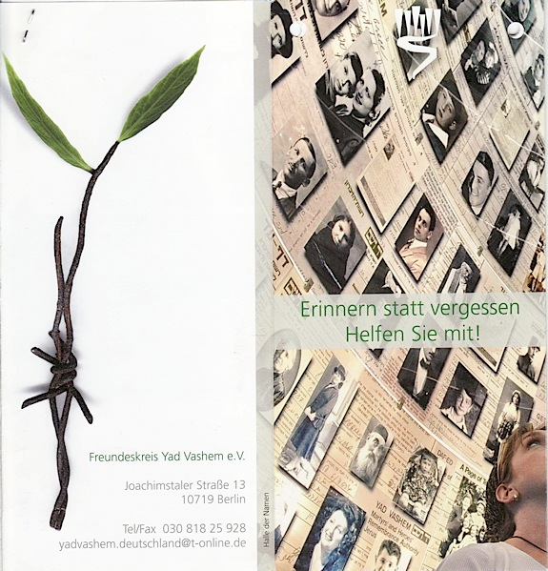
Everything is
Forbidden
And Yet
We Do Everything
Spiritual Resistance
during the Holocaust

Slide 2
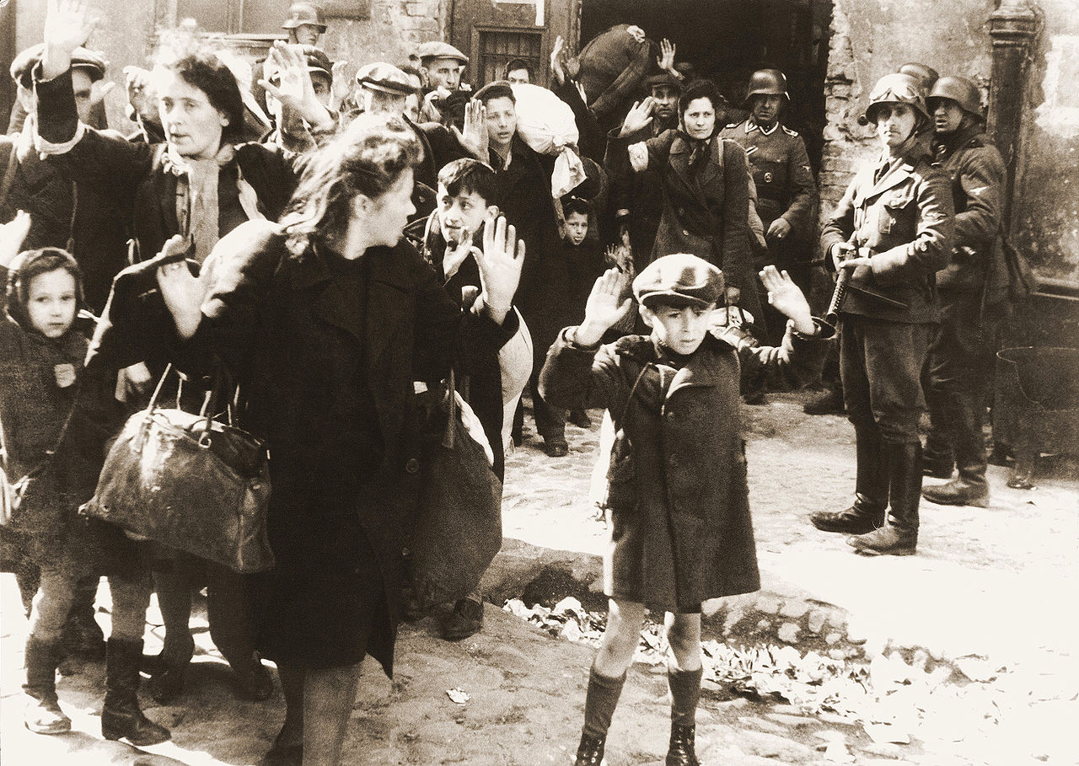
Notes:
Removing people from the Warsaw Ghetto

Slide 3
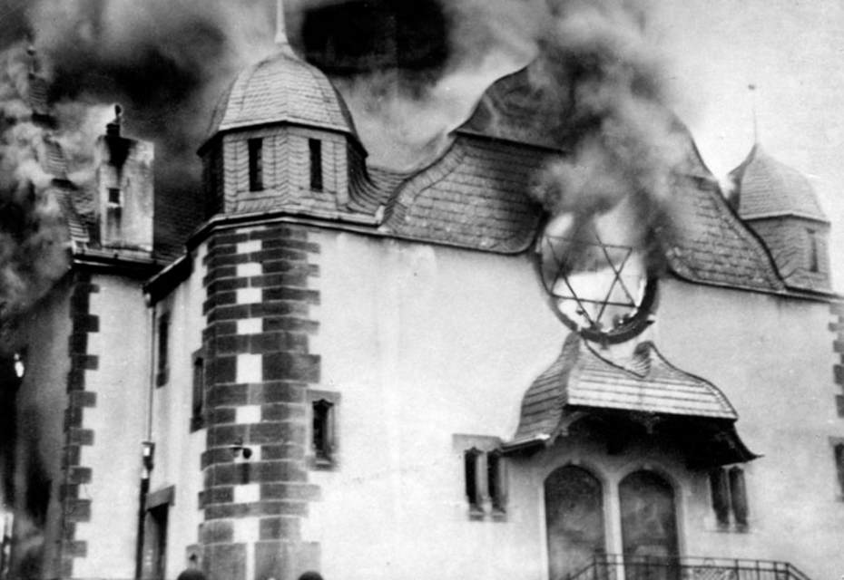
Notes:
Cultural Destruction: Siegen, Germany (Kristallnact)

Slide 4
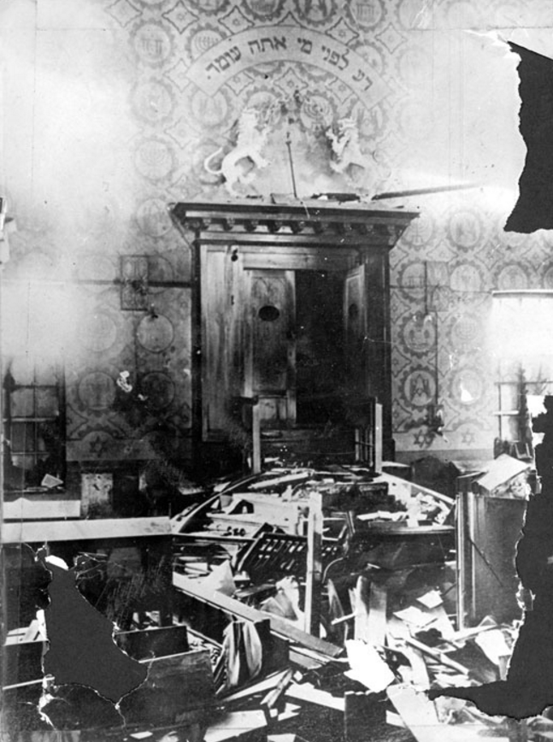
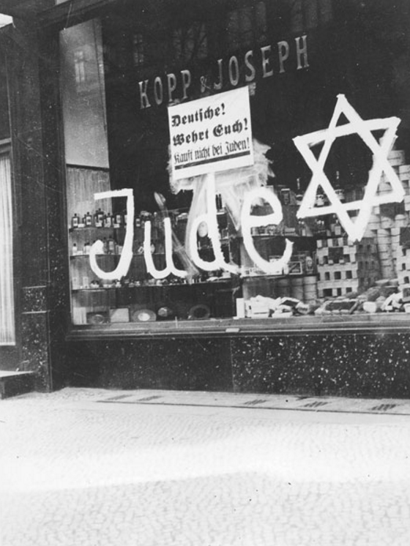
Notes:
Cultural Destruction: Eschwege, Germany (after Kristalnacht); During the boycott

Slide 5
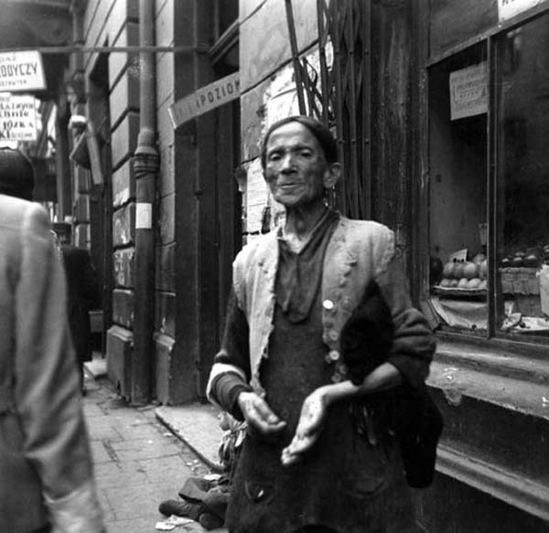
Notes:
Struggling to survive

Slide 6
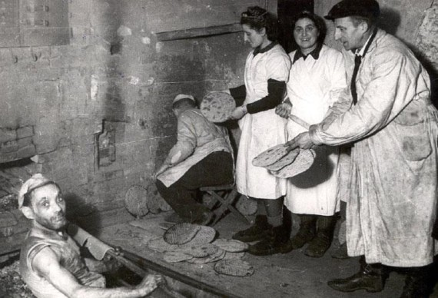
Notes:
Finding strength: Lodz, Poland (1943) – baking matzah in hiding

Slide 7
What is Resistance?
“In these days of our misfortune, we live the life of Marranos. Everything is forbidden to us, and yet we do everything”
Chaim Aharon, teacher, from his diary in the Warsaw Ghetto.

Slide 8
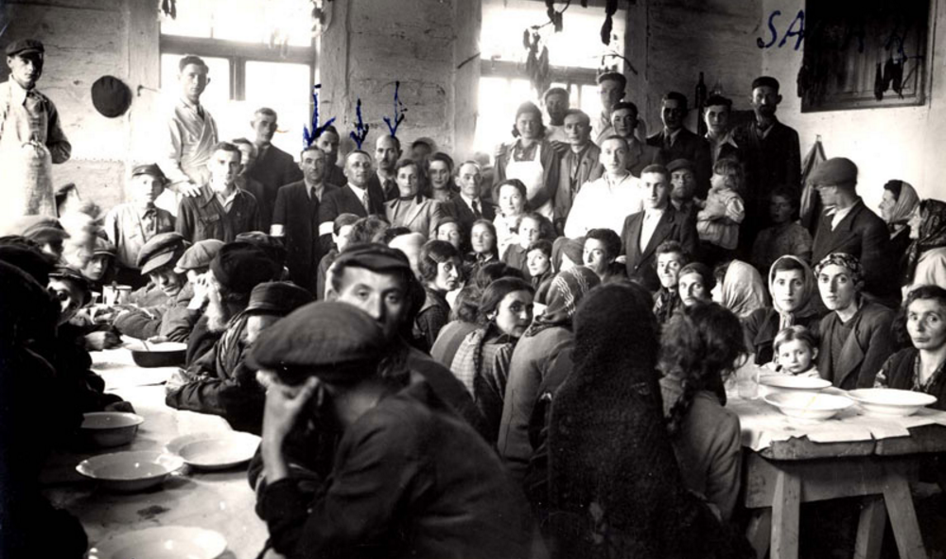
Notes:
Mutual Aid: Communal kitchen in Zelechow, Poland (1942)

Slide 9
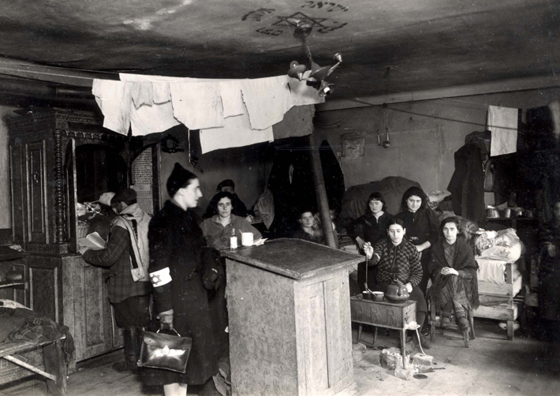
Notes:
Mutual Aid: Visit of a Jewish physician to a shelter for Jewish refugees from Lodz in the Warsaw Ghetto

Slide 10
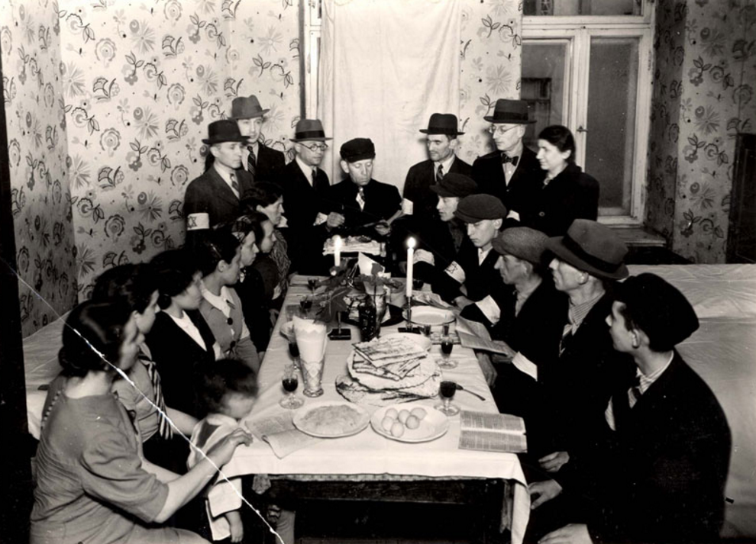
Notes:
Mutual Aid/Religious Observance: New arrivals to the Warsaw Ghetto celebrating Passover together

Slide 11
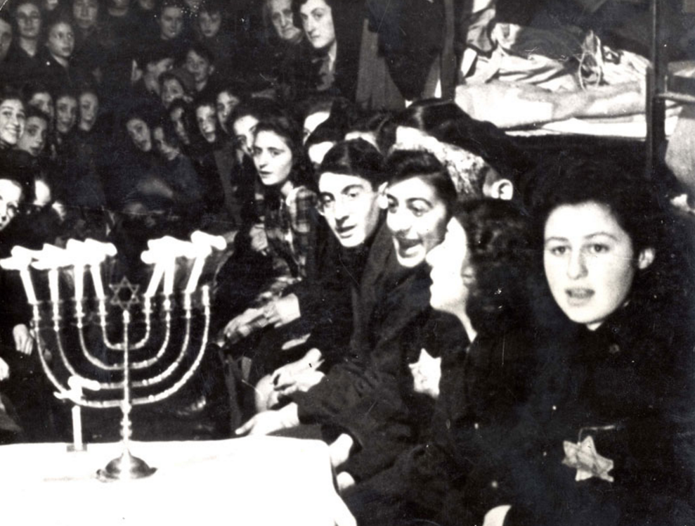
Notes:
Religious Observance: Chanukah in Westerbork, Holland (1943)

Slide 12
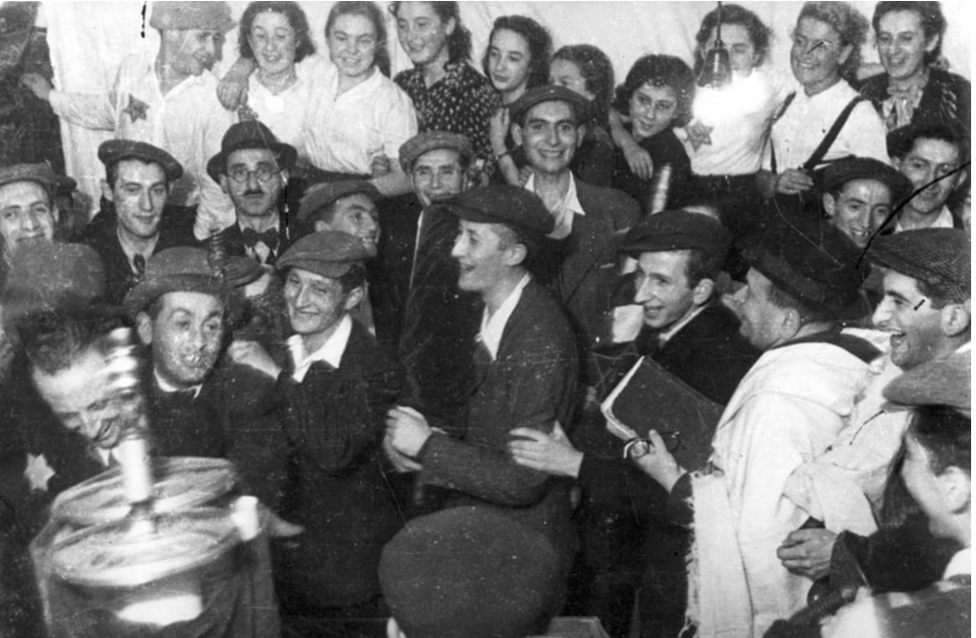
Notes:
Religious Observance: Dedicating a new Torah Scroll in the Lodz Ghetto

Slide 13
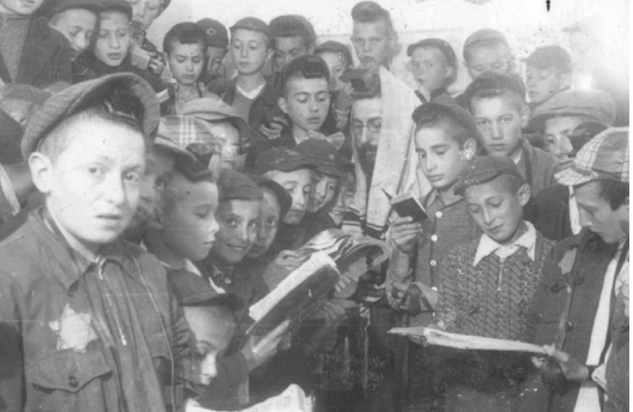
Notes:
Religious Observance/Education: Children praying (with a teacher) in the Lodz Ghetto

Slide 14
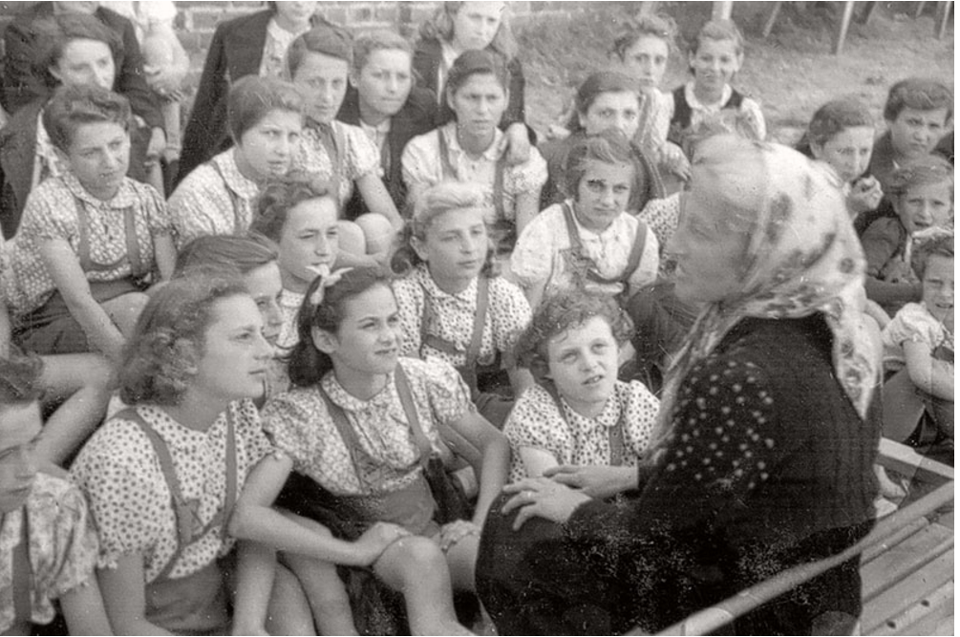
Notes:
Education: High School in Lodz

Slide 15
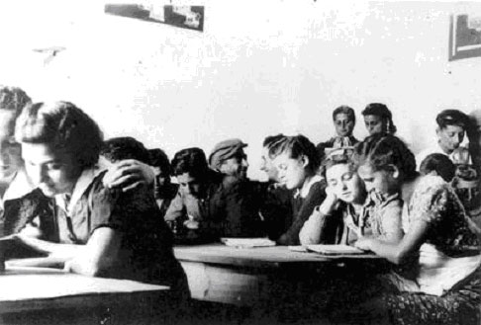
Notes:
Youth groups: Members of the Gordonia youth movement reading during a class, Lodz Ghetto, 1941.When schools stopped operating at the end of 1941, the youth movements became substitute learning centers. The Zionist youth movements, including Gordonia, placed a special emphasis on learning Hebrew.

Slide 16
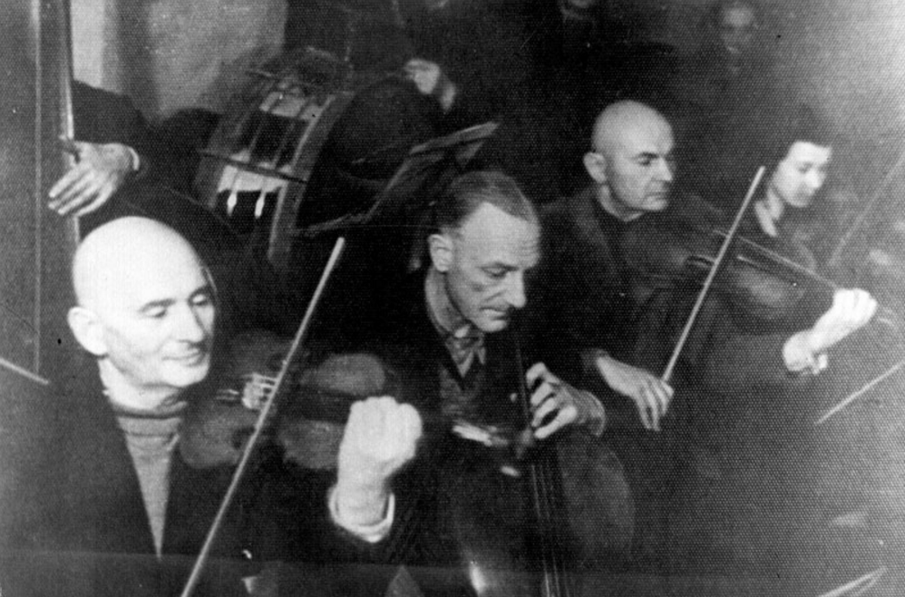
Notes:
Culture: the Kovno Ghetto Orchestra

Slide 17
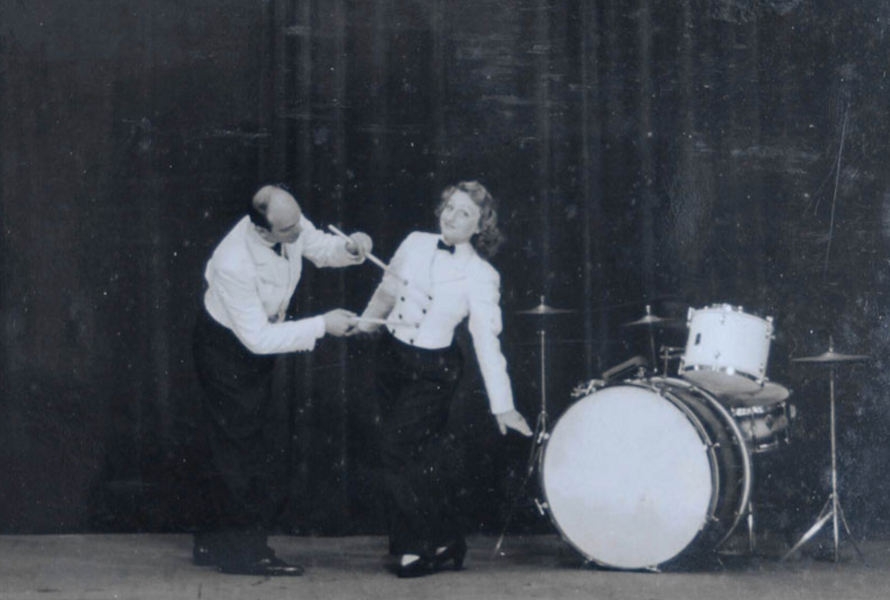
Notes:
Culture: Westerbork, Holland (1943)

Slide 18
Theater in a Graveyard?
“Today I received a formal invitation from a group of founding Jewish artists in the ghetto announcing that the first evening of the local artistic circle will be held… in the auditorium of the Real Gymnasium at Rudnicka.
A dramatic and vocal musical program will be presented… I felt offended, personally offended… Here, in the doleful situation of the Vilna ghetto, in the shadow of Ponar, where, of the 76,000 Vilna Jews, only some 15,000 remain – here, at this moment, this is a disgrace.”
“You don't make a theatre in a graveyard.”
- Herman Kruk (political activist)

Slide 19
On the other hand…
“Nevertheless, life is stronger than anything. In the Vilna ghetto, life begins to pulse again. Under the overcoat of Ponar, a life creeps out that strives for a better morning. The boycotted concerts prevail. The halls are full. The literary evenings burst their seams, and the local hall cannot hold the large number that comes there.”
- Herman Kruk (two months later)

Slide 20
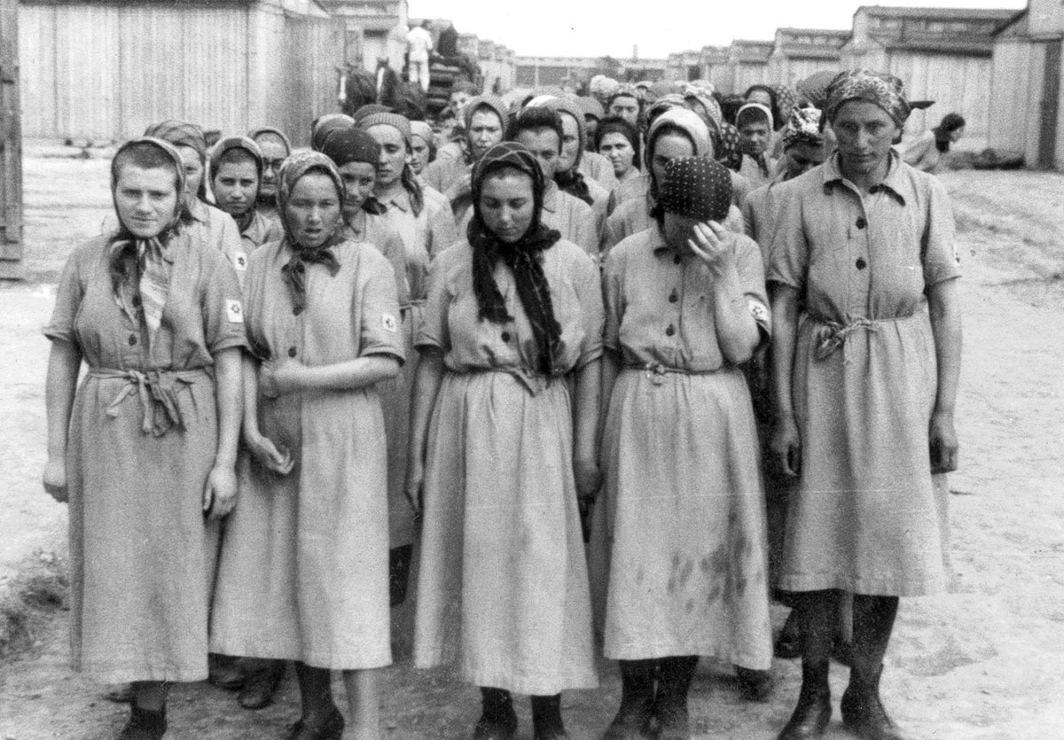
Notes:
In the camps: Women assigned to slave labor (Auschwitz)

Slide 21
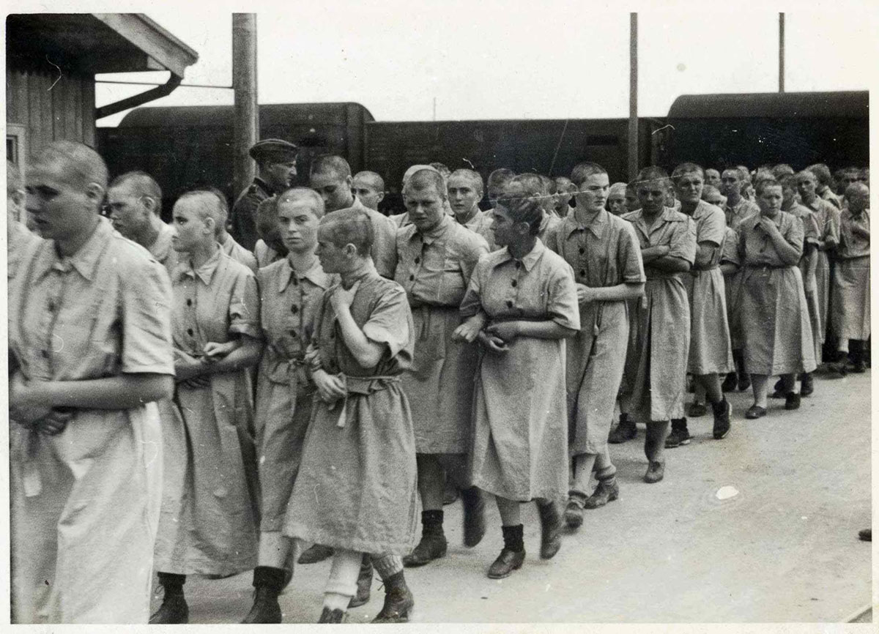

Slide 22
Poetry in Auschwitz
Jewish women, deported via Auschwitz to a labor camp in Germany, organized study groups in 1944.
Each woman was asked to write down poetry from memory on a piece of paper, using pencils gathered painstakingly from the ruins of the bombed-out buildings where they labored.
"After a few days we were seated in a circle writing, and a few days later held our first reading. We invited guests from the other blocks and declaimed grandly until we almost forgot where we were.”
- Hedy Fried

Slide 23
Prayer in Buchenwald
“As the evening drew near, a few of us gathered between the bunks for the Friday evening service.... as I began to whisper the familiar words ..., I was lulled by a feeling of tranquility.…
I discovered for the first time in my life the real power and value of prayer and faith in God.
I could feel my words shattering the iron gates and the high powered fences, going past the hundreds of guards, dugouts, and watchtowers, out into the open, reaching towards heaven.
Here, I knew, was a way of escape, a source of strength and a means of survival of which no power on earth could deprive me.”
- Simcha Unsdorfer

Slide 24
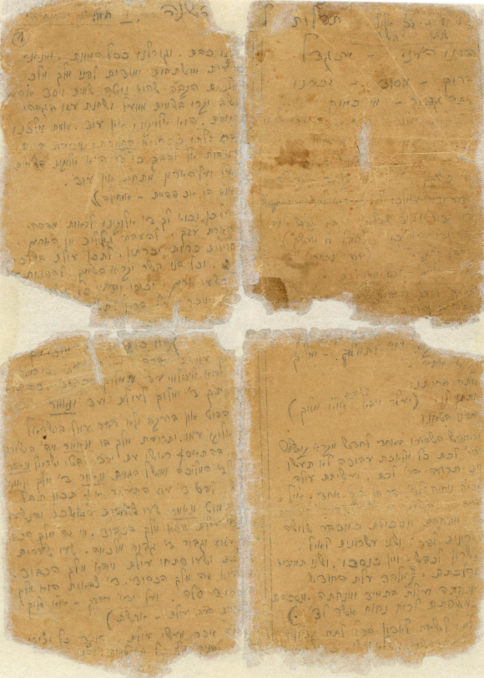
The Wolfsberg Machzor

Slide 25
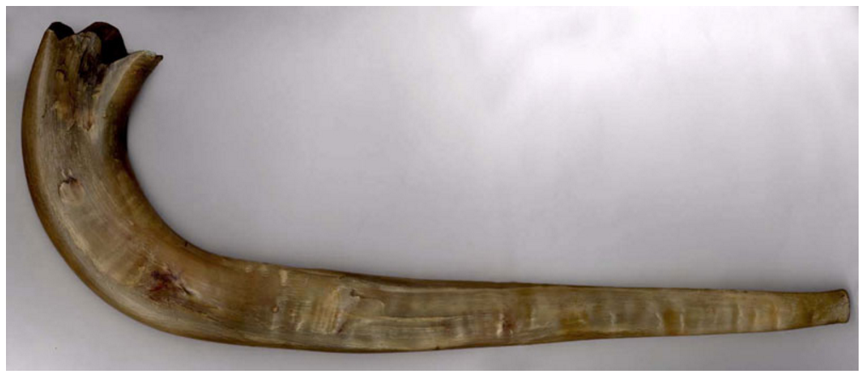
The Skarzysko-Kamienna Shofar

